Slide 1
God’s Word of the Week

Slide 2
Praise be to the God and Father of our Lord Jesus Christ! In his great mercy he has given us new birth into a living hope through the resurrection of Jesus Christ from the dead. 1 Peter 1:3
God’s word for the week:

Slide 4
Paradise

Slide 6
2 Corinthians 1:3–10 (ESV)
³ Blessed be the God and Father of our Lord Jesus Christ, the Father of mercies and God of all comfort, ⁴ who comforts us in all our affliction, so that we may be able to comfort those who are in any affliction, with the comfort with which we ourselves are comforted by God. ⁵ For as we share abundantly in Christ’s sufferings, so through Christ we share abundantly in comfort too.

Slide 7
2 Corinthians 1:3–10 (ESV)
⁶ If we are afflicted, it is for your comfort and salvation; and if we are comforted, it is for your comfort, which you experience when you patiently endure the same sufferings that we suffer. ⁷ Our hope for you is unshaken, for we know that as you share in our sufferings, you will also share in our comfort. ⁸ For we do not want you to be unaware, brothers, of the affliction we experienced in Asia.

Slide 8
2 Corinthians 1:3–10 (ESV)
For we were so utterly burdened beyond our strength that we despaired of life itself. ⁹ Indeed, we felt that we had received the sentence of death. But that was to make us rely not on ourselves but on God who raises the dead. ¹⁰ He delivered us from such a deadly peril, and he will deliver us. On him we have set our hope that he will deliver us again.

Slide 9
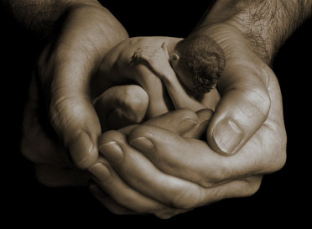
God is the source of mercy and comfort

Slide 10
We will all face suffering and it will expose the limits of our strength

Slide 11
The Resurrection gives us the comfort of hope and meaning in suffering

Slide 12
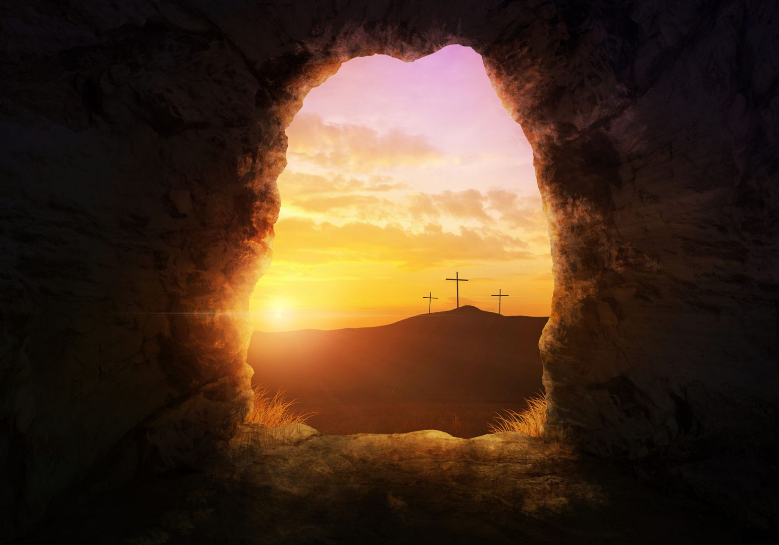
The Resurrection gives us the comfort of hope and meaning in suffering

