Slide 1
God’s Word of the Week

Slide 2
For in him all the fullness of God was pleased to dwell. Colossians 1:19
God’s word for the week:

Slide 4
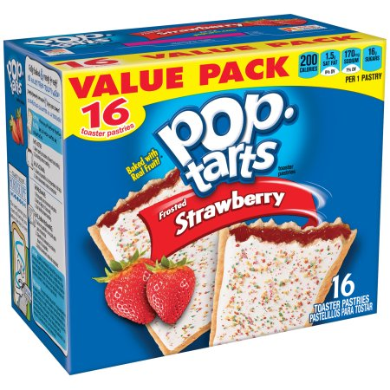
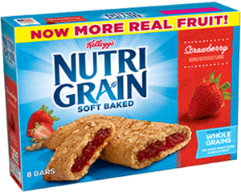

Slide 5
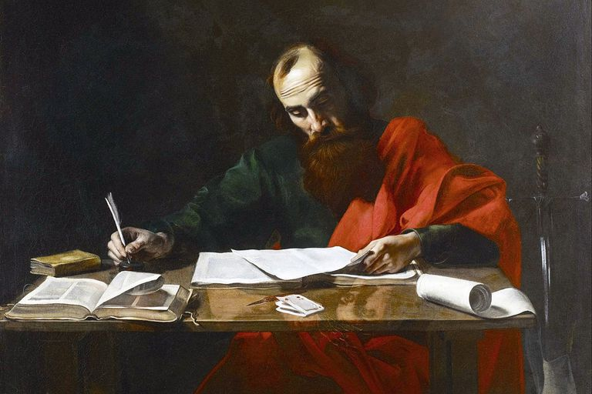
Background to Paul’s Letter to the Colossians

Slide 6
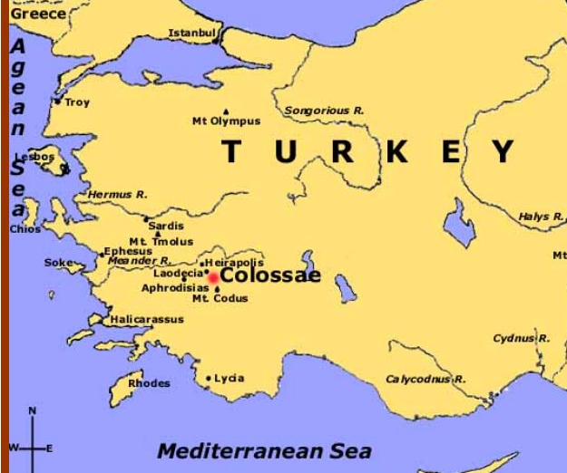
Young and Healthy Church Plant
Growing influence of “Colossian Heresy”

Slide 7
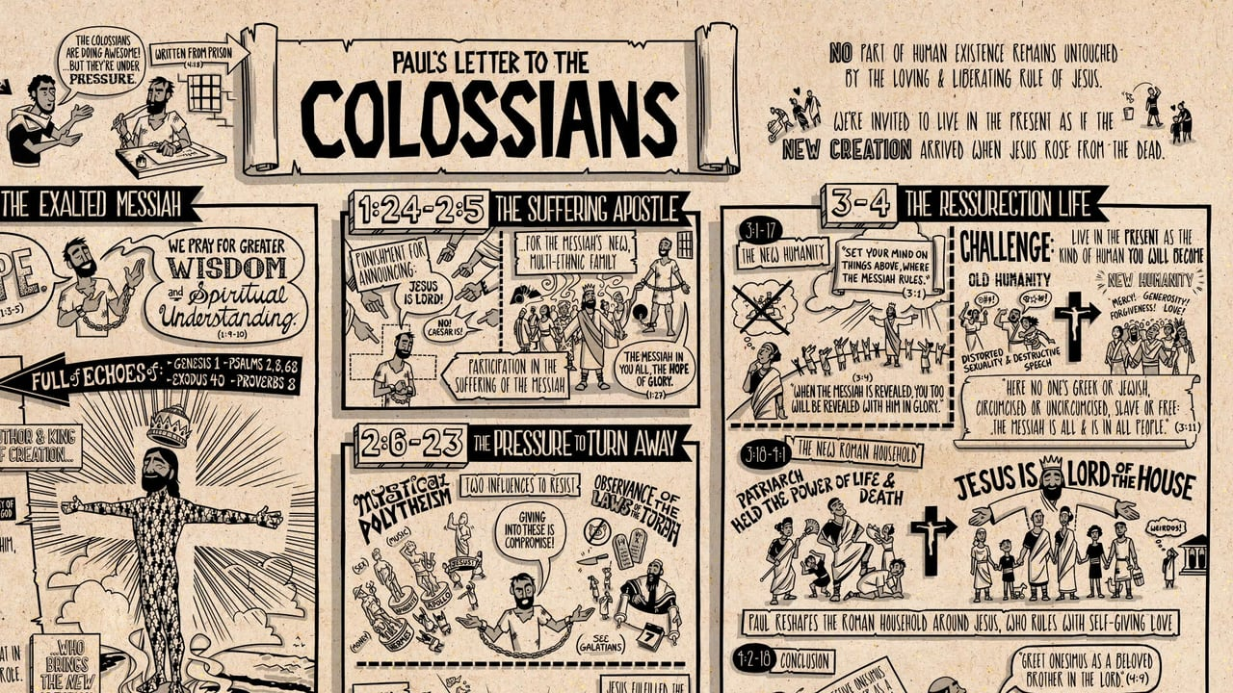
Main Themes of Colossians:

Slide 8
True Wisdom, Knowledge, and Understanding
Colossians 1:9 (ESV) 9 And so, from the day we heard, we have not ceased to pray for you, asking that you may be filled with the knowledge of his will in all spiritual wisdom and understanding,
Colossians 2:3 (ESV) 3 in [Christ] are hidden all the treasures of wisdom and knowledge.
Colossians 2:8 (ESV) 8 See to it that no one takes you captive by philosophy and empty deceit, according to human tradition, according to the elemental spirits of the world, and not according to Christ.
Colossians 2:21–23 (ESV) 21 “Do not handle, Do not taste, Do not touch” 22 (referring to things that all perish as they are used)—according to human precepts and teachings? 23 These have indeed an appearance of wisdom in promoting self-made religion and asceticism and severity to the body, but they are of no value in stopping the indulgence of the flesh.

Slide 9
Supremacy of Christ
Colossians 1:15 (ESV) 15 He is the image of the invisible God, the firstborn of all creation.
Colossians 1:18–19 (ESV) 18 And he is the head of the body, the church. He is the beginning, the firstborn from the dead, that in everything he might be preeminent. 19 For in him all the fullness of God was pleased to dwell,
Colossians 2:9–10 (ESV) 9 For in him the whole fullness of deity dwells bodily, 10 and you have been filled in him, who is the head of all rule and authority.

Slide 10
Centrality Christ
Colossians 1:16–17 (ESV) 16 For by him all things were created, in heaven and on earth, visible and invisible, whether thrones or dominions or rulers or authorities—all things were created through him and for him. 17 And he is before all things, and in him all things hold together.

Slide 11
Sufficiency of Christ
Colossians 2:6–8 (ESV) 6 Therefore, as you received Christ Jesus the Lord, so walk in him, 7 rooted and built up in him and established in the faith, just as you were taught, abounding in thanksgiving. 8 See to it that no one takes you captive by philosophy and empty deceit, according to human tradition, according to the elemental spirits of the world, and not according to Christ.

Slide 12
Resurrection
Colossians 2:12–13 (ESV) ¹² having been buried with him in baptism, in which you were also raised with him through faith in the powerful working of God, who raised him from the dead. ¹³ And you, who were dead in your trespasses and the uncircumcision of your flesh, God made alive together with him, having forgiven us all our trespasses,
Colossians 3:1–2 (ESV) ¹ If then you have been raised with Christ, seek the things that are above, where Christ is, seated at the right hand of God. ² Set your minds on things that are above, not on things that are on earth.

Slide 13
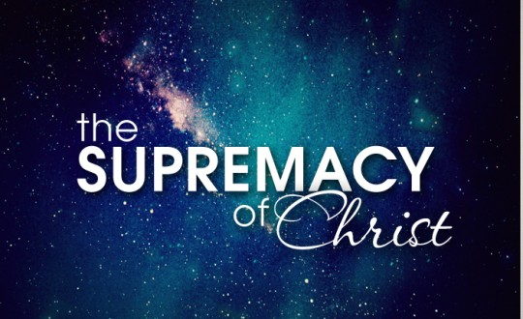
The Message of Colossians:

Slide 14
John Piper
Seeing and savoring the supremacy of Jesus Christ frees you from the slavery of sin for the sacrifices of love…
Being satisfied with all that God is for you in Jesus frees you from the bondage of sin for the suffering of love.

Slide 15
The Message of Colossians:

