Slide 1
God’s Word of the Week

Slide 2
Romans 1:16 I am not ashamed of the gospel, because it is the power of God for the salvation of everyone who believes: first for the Jew, then for the Gentile.
God’s word for the week:

Slide 4
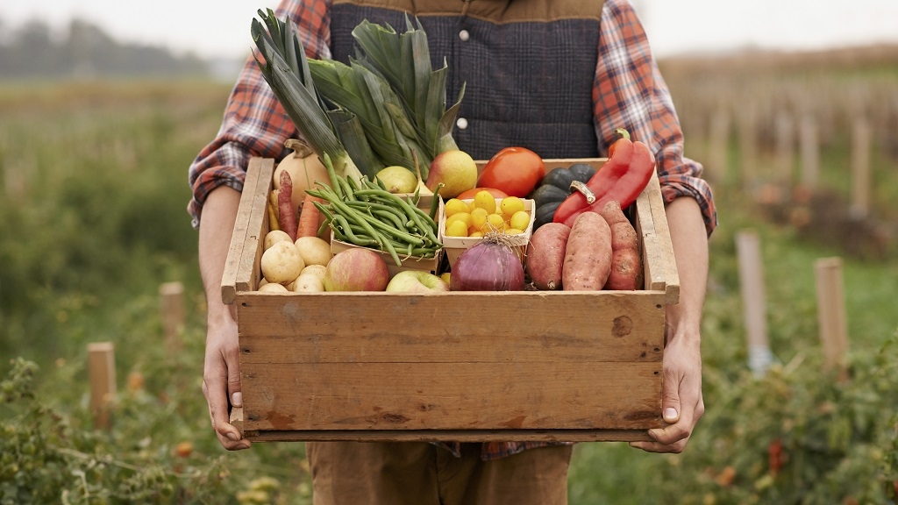

Slide 5
The Gospel produces the fruit of faith and love

Slide 6
N.T. Wright
‘The gospel’, for Paul, is an announcement, a proclamation, whose importance lies in the truth of its content. It is not, primarily, either an invitation or a technique for changing people’s lives. It is a command to be obeyed and a power let loose in the world…

Slide 7
N.T. Wright
God is doing through the gospel what he always intended to do. He is sowing good seed in the world, and preparing to reap a harvest of human lives recreated to reflect his glory.

Slide 8
The Gospel produces the fruit of faith and love

Slide 9
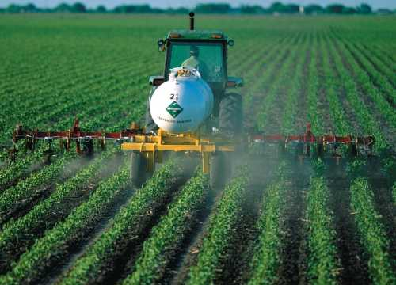
Faith needs spiritual fuel to continue producing God honoring Gospel Fruit.

Slide 10
We need the spiritual fuel of: Knowledge of God’s will in wisdom and understanding

Slide 11
N.T. Wright
The ‘knowledge of God’s will’ is more than simply an insight into how God wants his people to behave: it is an understanding of God’s whole saving purpose in Christ, and hence a knowledge of God himself

Slide 12
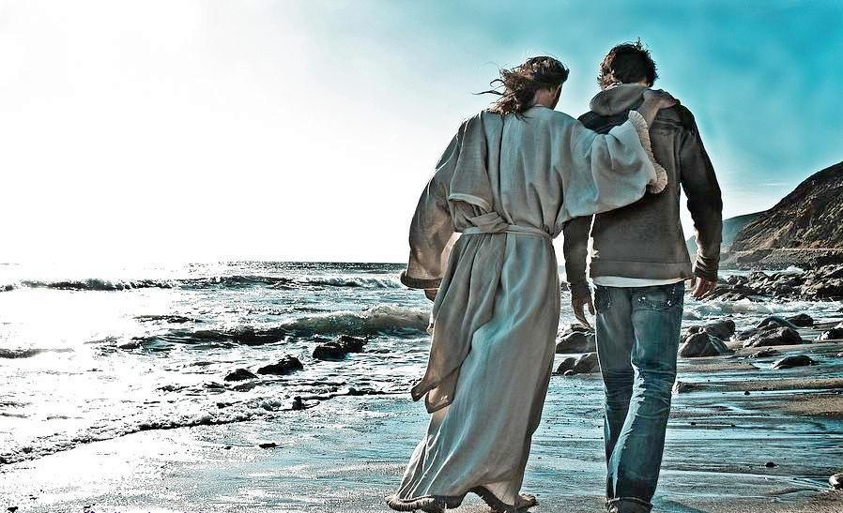
We need the spiritual fuel of: Knowledge of God’s will in wisdom and understanding

Slide 13
We need the spiritual fuel of: Knowledge of God’s will in wisdom and understanding

Slide 14
We need the spiritual fuel of: Strength from God’s mighty power

Slide 15
Peter O’Brien
The standards set before the Colossians were far higher than those of the false teachers. And nothing short of God’s almighty power at work within them would enable them to live so as to please him in all things.

Slide 16
We need the spiritual fuel of: Strength from God’s mighty power

